Slide 1
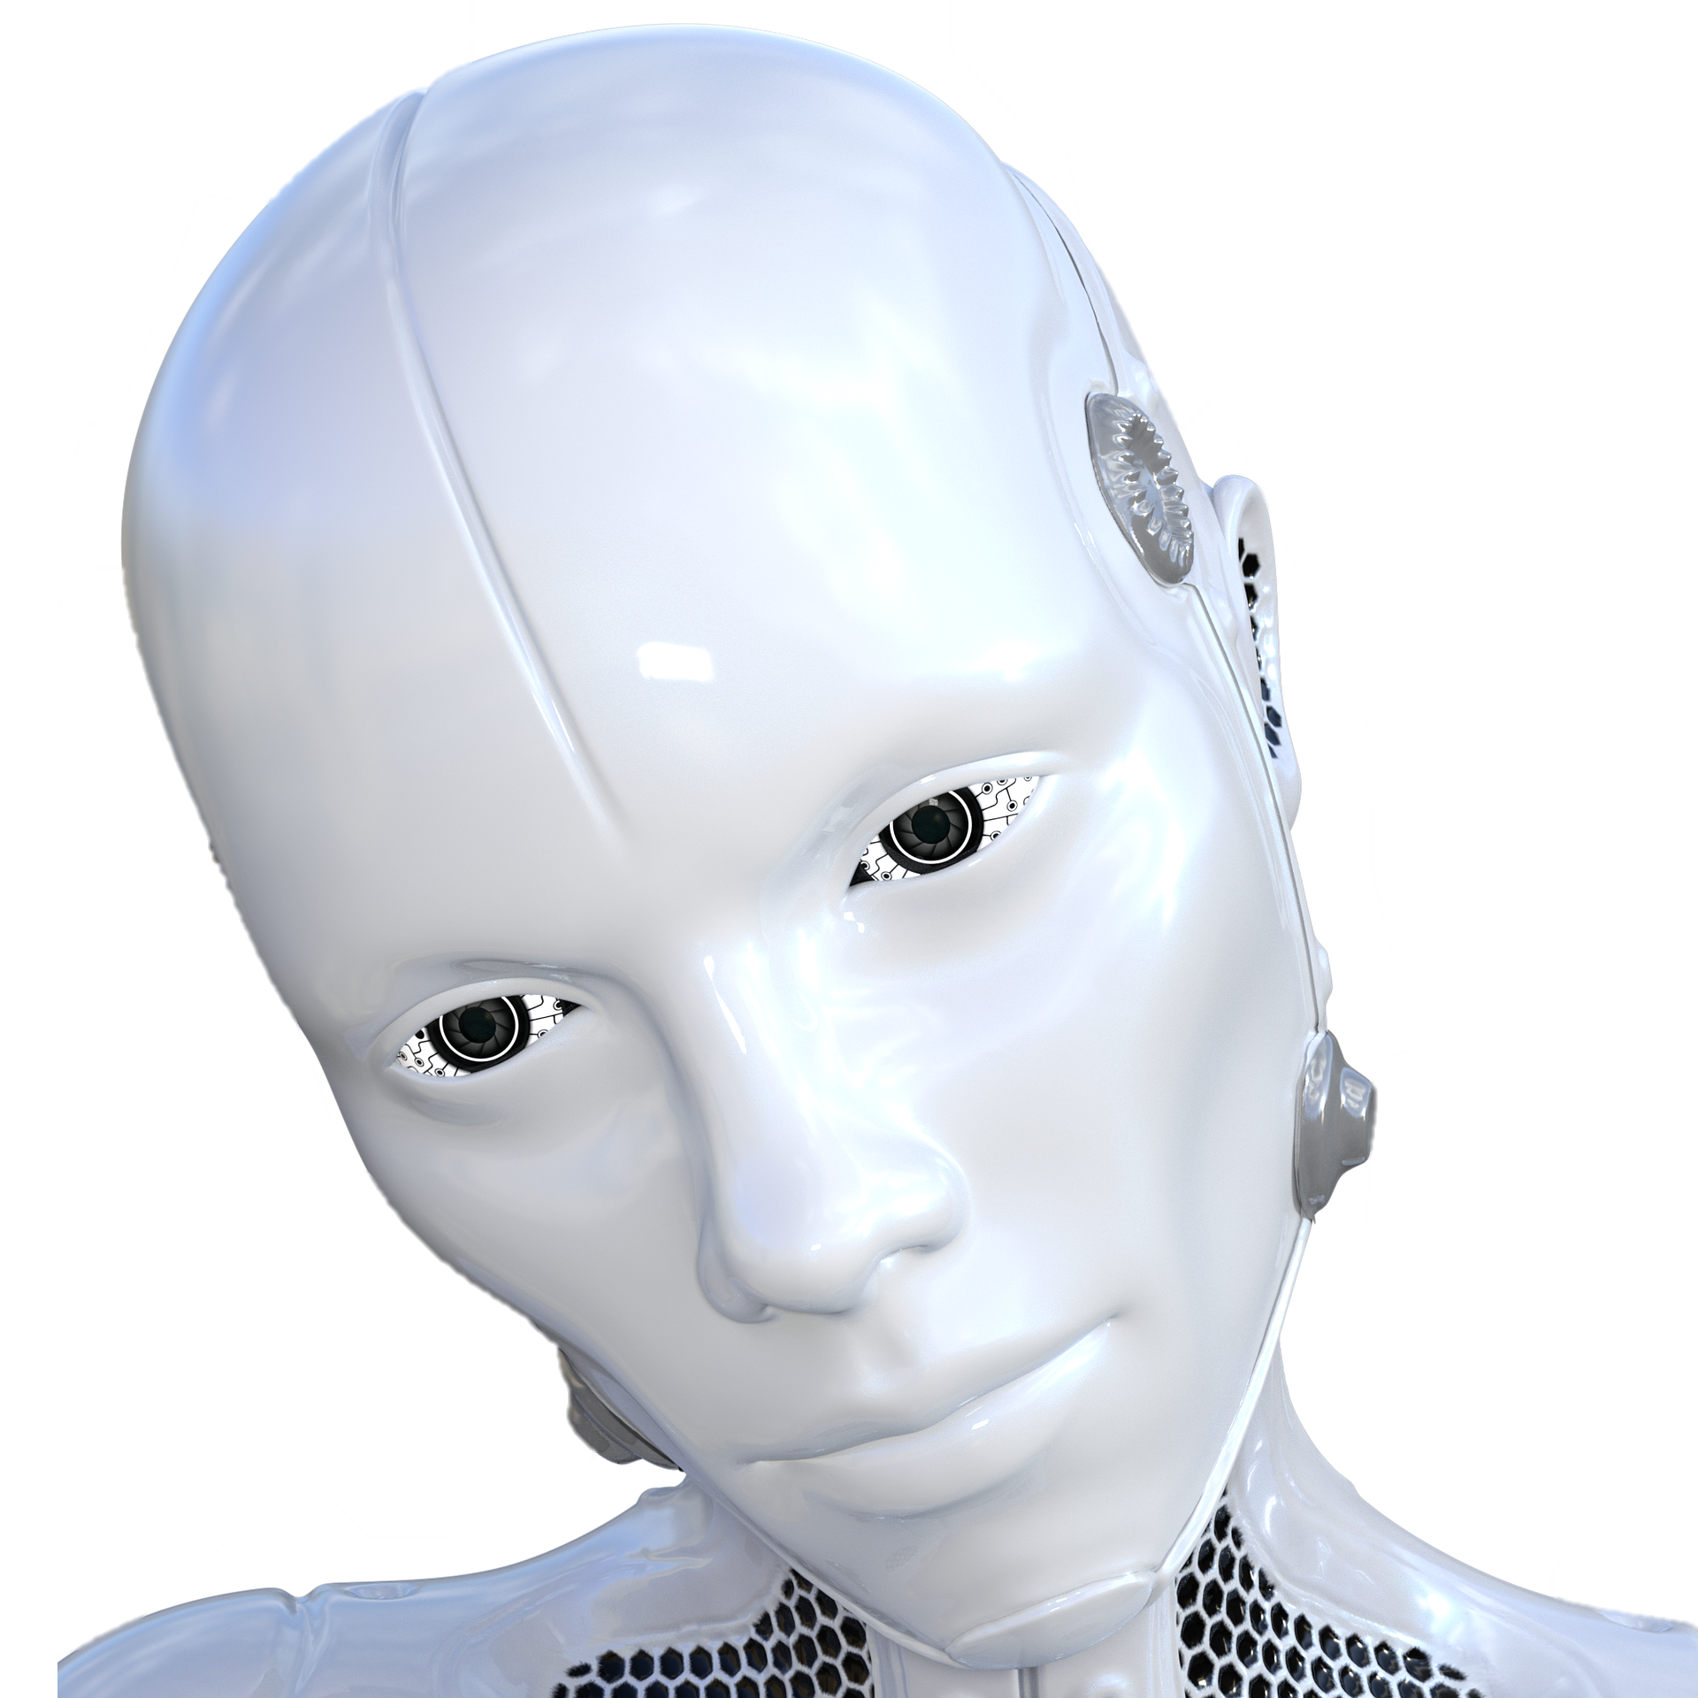
Starter Task:
Meet Hayley the robot she has been purchased as a gift for a family with young children.
This robot is required to complete a range of activities some of theses are:
Making hot drinks for family members.
Reading a story to the young children at night time.
As the lead programmer for Hayley you have been asked to pick one of the tasks above and note down all of the tasks she will need to carry out to complete the activity. (Ensure you are detailed with your response)
Computational Thinking: Solving problems by breaking the problem into smaller stages and thinking in a logical manner.

Slide 2
1.1 Computational Thinking:
Abstraction
Decomposition
Algorithmic Thinking
1.2 Standard Searching Algorithms:
Binary Search
Linear Search
1.3 Standard Sorting Algorithms:
Bubble Sort
Merge Sort
Insertion Sort
Topics to be learnt within this unit:
1.4 How to produce algorithms using:
Pseudocode
Using flow diagrams
1.5 Interpret, correct or complete algorithms
An algorithm is a list of rules to follow in order to solve a problem. – BBC Bitesize

Slide 3
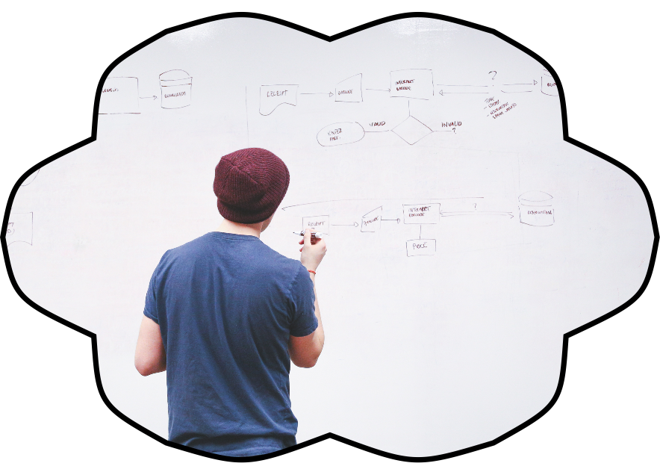
Computational Thinking:
Computer systems have been programmed and controlled by computer scientists for roughly 82 years and they are also developing solutions to problems that we expect to see in the future
Computational thinking is being able to:
Review a complex problem.
Understand how a problem works and operates.
Formulate a solution that can be implemented by either a human or a computer system.
The first programmed computer system the Z1 was created by German Konrad Zuse in his parents living room between 1936 to 1938.

Slide 4


Problem Solving:
You are going on a camping trip.
In pairs plan out your trip.
What will you need?
Where will you go camping?
What activities will you do?
How long will you stay there?
Algorithm: A Series of steps designed to solve a problem.

Slide 5
Problem Solving Stages:
When solving a problem within Computer Science there are some stages that really aid in solving any task and this can be applied to programming projects also that you might complete.
Breakdown the Problem.
Design the Solution.
Implementation.
Review.
Task Sheet:
You have been given the basic headings for the different stages of problem solving.
Match up the stages with the different tasks/questions that are completed within the stage.
Program: Self contained set of instructions that can be used by the CPU of a computer system.

Slide 6
Applying your subject knowledge.
Using the points we have discussed in relation to problem solving and computational thinking use stages 1 and 2 of the problem solving model to approach the below scenario.
You have been approached by a software engineering company and have been asked to develop a virtual reality product that can be used by a building company to showcase a new house to future buyers.
Stage 1: Breakdown the problem
What do you need to know?
Is the problem solvable?
Can the problem be broken into smaller tasks to be solved?
Stage 2: Design the Solution
List the things you will need to do.
Are there any similar problems?
Has the problem been solved before?
Sequence: When a list of instructions is carried out in order, one after the other.

Slide 7
Abstraction.
Abstraction is taking real-life situations and modelling it so that we can review it and think about it in a more effective manner than you might not be able to do normally. Abstraction is used to let us see the component parts of a large problem which is used to help us tell the difference between what is important and what is not by filtering out unnecessary details.
Some examples of abstraction are:
A function in a program is a form of abstraction which is used to complete particular task.
Layers in a network(See network layers lesson) this splits up the functional aspects of networks into separate more management tasks so you can review what is important at each stage.
Maps: Map is used to provide us a paper based version of the surface of the earth.
Problem: Something that needs to be solved.

Slide 8

Abstraction.
Still not sure?
Imagine if somebody said to you that they had seen a car. We know what they mean because we abstracted all the essential features into a mental image of what we know as a car. We filtered out all of the unnecessary detail.
Flow chart: Visual diagram to support the development of algorithms to solve a given problem.

Slide 9
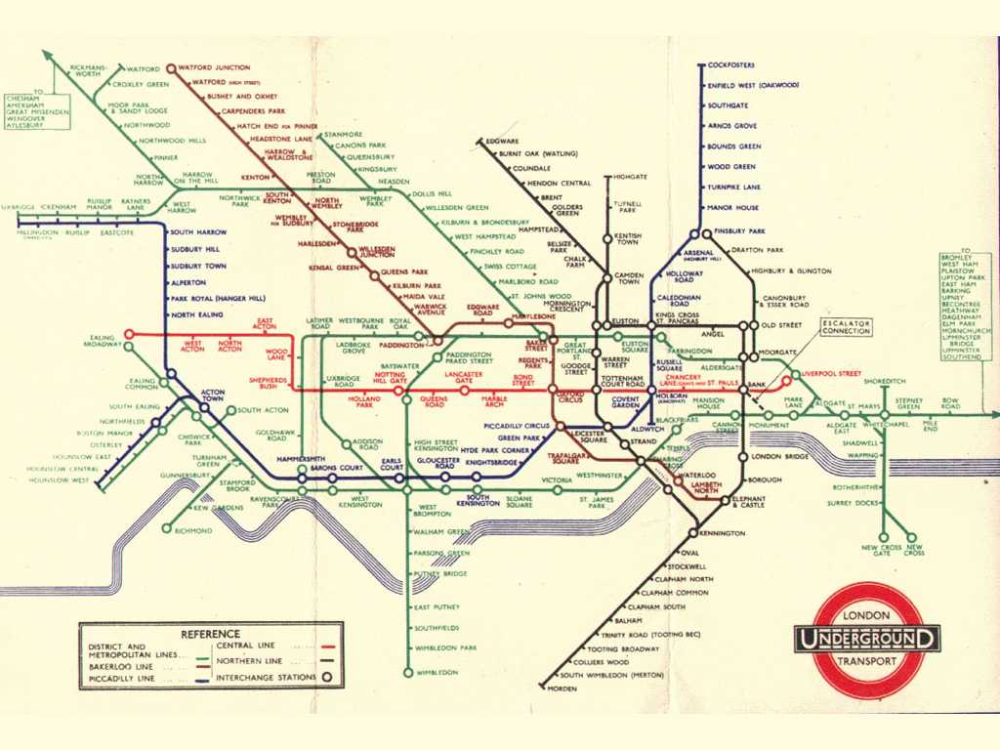
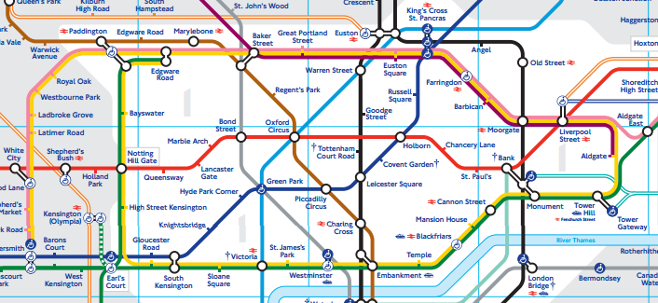
Abstraction.
Thinking Task:
What is this image?
Which image is the abstraction?
Explain why you have made this choice.
Image 1
Image 2
Computational Thinking: Solving problems by breaking the problem into smaller stages and thinking in a logical manner.

Slide 10

Decomposition
In Computational thinking this is another key stage that must be learnt and used to deal with the complexity of problems that are given to you.
Decomposition requires you to break a problem down into smaller chunks that are much more manageable to aid in supporting the development of a solution. This links to stage 1 of problem solving that we covered earlier.
Breaking a problem down into smaller parts “Chunks” which makes the problem easier to solve.
An algorithm is a list of rules to follow in order to solve a problem. – BBC Bitesize

Slide 11

Decomposition
In a small group allocated to you by your teacher break the following problem down into sensible steps that make it easier to plan and solve.
You have been asked to set up a fun raising event in your local town from scratch that will require you to host the event, raise money and advertise.
Breakdown the problem into smaller tasks that will need to be solved.
The first programmed computer system the Z1 was created by German Konrad Zuse in his parents living room between 1936 to 1938.

Slide 12

Hold up! We have covered a lot of content lets see what you know.
In the previous task you were asked to setup a fun raising event. If you were to advertise the event to your local community what would be the abstraction that will be completed?
Another stage we haven’t covered is pattern recognition. Research and explain what you think this concept means for discussion point.
What are the 4 stages of problem solving?
Why do we need to develop our computational thinking skills to be able to solve complex problems?
Sequence: When a list of instructions is carried out in order, one after the other.

Slide 13
Questions:
Describe a problem that can be solved, at least in part, by the combination of human and computer resources.
Describe a problem that can be completely solved by using a computer system.
Challenging questions that require extended writing skills so give them a good go!
Decomposition: Breaking a problem down into smaller chunks to support solving of a solution.

Slide 14
Lesson Summary:
Computational Thinking:
Review a complex problem.
Understand how a problem works and operates.
Formulate a solution that can be implemented by either a human or a computer system.
Problem Solving:
Breakdown the Problem.
Design the Solution.
Implementation.
Review.
Abstraction: help us tell the difference between what is important and what is not by filtering out unnecessary details.
Decomposition:
Breaking a problem down into smaller parts “Chunks” which makes the problem easier to solve.
Pattern recognition: Spotting trends and patterns and using these to support problem solving.
Abstraction: Hiding unneeded information.

